Slide 1
Identifying and Mitigating Fairness and Bias Risks
What Are Fairness and Bias?
Identify Bias Risks
Fairness Tradeoffs
Mitigate Bias Risks

Slide 2
What Are Fairness and Bias?
Topic A

Slide 3
Fairness and Bias
Fairness
Treating people “as equals”
Giving each person his or her due
Justifying any departures from equality
Bias
Treating people unfairly
Discriminating against people
Can be intentional but often is not

Slide 4

Differential Treatment
Treating people differently is not inherently unfair.
Special concerns about “protected” characteristics or groups.

Slide 5



Bias in Data-Driven Technologies
The world as it could and should be
The world as it is
The world according to data
Source: Annual Review of Statistics and Its Application, Vol. 8

Slide 6
Types of Bias (Slide 1 of 2)
Types of Bias | Description and Example
Implicit bias | Description: Stereotypes unconsciously held about certain people or groups. Example: Instinctively clutching one’s wallet when passing a member of another race on the street.
Automation/ complacency bias | Description: Tendency to trust decisions produced by automated systems more than human decisions. Example: Trusting an online symptom checker more than the diagnosis of a doctor.
Sampling bias | Description: Sample data that does not reliably represent the target population. Example: Estimating national population characteristics based on data from a single postal code.
Confirmation/ reinforcement bias | Description: Discounting information that challenges our prior beliefs or values. Example: Giving greater weight to scientific studies that support your pre-existing opinion on a topic.

Slide 7
Types of Bias (Slide 2 of 2)
Types of Bias | Description and Example
Cultural bias | Description: Assuming aspects of one’s own cultural experience are universal. Example: Academic assessments that test skills or use examples that are more familiar to certain ethnic groups.
Gender bias | Description: Treating the particular interests of one gender as the norm. Example: Failing to appreciate how pregnancy or care-giving may impose particular burdens on women.
Ableism bias | Description: Failing to account for the interests of disabled persons. Example: Designing a vehicle based on data from people with full use of their arms and legs.
Temporal bias | Description: Believing or valuing something more because of its location in time. Example: Being more confident about an exam when it is scheduled in the distant future.
Sociological bias | Description: Stereotyping individuals who are less like oneself. Example: Holding negative beliefs about employees of a rival company.

Slide 8
Fairness Principles (Slide 1 of 2)
Group unawareness
Outputs take no account of individuals’ membership in protected groups.
A credit scoring model omits race and other parameters that might be proxies for race.
Rates of success are equal for members of protected and unprotected groups.
Download rates of a dating app are the same for LGBTQ+ and non-LGBTQ+ individuals.
Rates of success are proportional to a group’s prevalence in the broader population.
Company boards are staffed with 50% women.
Statistical parity
Demographic parity

Slide 9
Fairness Principles (Slide 2 of 2)
Individuals with the same qualifications have equal chances of success.
Individuals who pass the CEET exam have the same rates of success in job applications.
Protected and unprotected groups have the same rate of correct/incorrect classification.
The % of mistaken predictions about recidivism is the same for racial minorities and the dominant group.
Success criteria are sensitive to differences among different groups.
Although high schools in a state vary widely in test scores and demographic composition, the top students at each school receive scholarships to the state university.
Formal equality of opportunity
Equal accuracy
Group awareness

Slide 10
Activity: Discussing Bias
Scenario: General discussion. You discussed the following types of bias:
Implicit bias
Automation/complacency bias
Sampling bias
Confirmation/reinforcement bias
Cultural bias
Can you brainstorm one additional example of bias from at least five of the types of bias discussed in this topic?
Which of these biases are relevant in the context of emerging technologies? Why?
Gender bias
Ableism bias
Temporal bias
Sociological bias

Slide 11
Identify Bias Risks
Topic B

Slide 12
Sources of Bias Risks
Data collection and sampling methods
Overfitting to training data
Edge cases
Use/Integration of third-party products

Slide 13
Methods for Identifying Bias Risks
Statistical analysis
Disparate impact modeling
Testing in different environments

Slide 14
Tools for Identifying Bias Risks
Bias bounties
Third-party toolkits
Radioactive data tracing

Slide 15
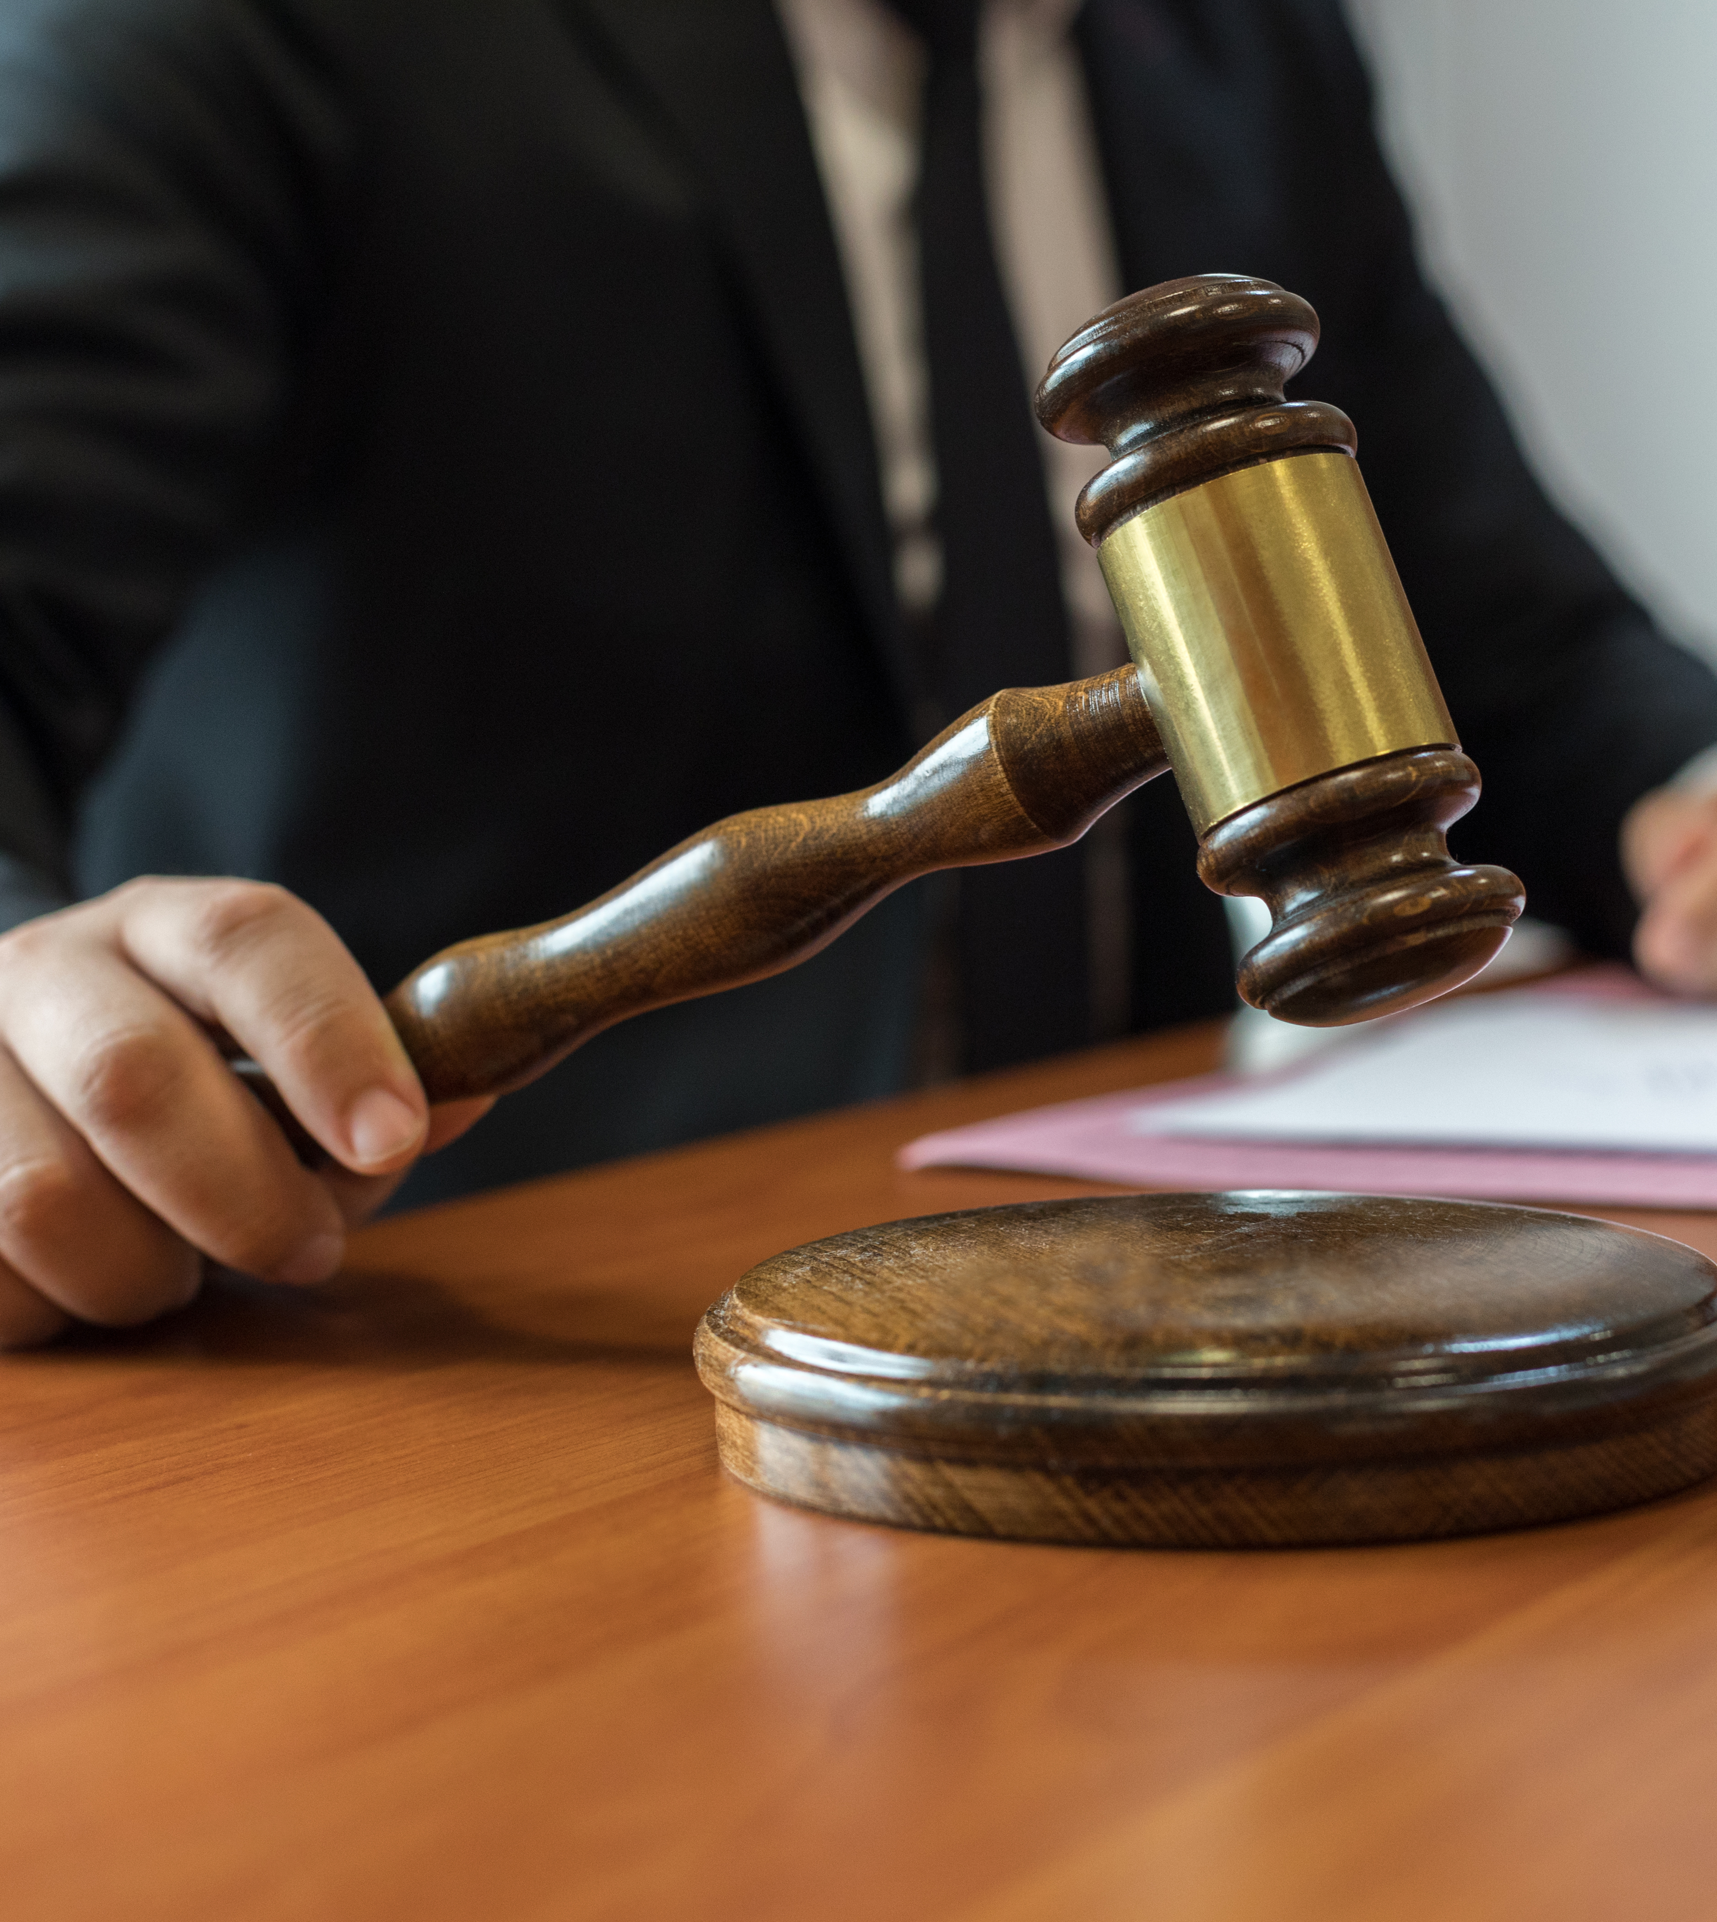
Fairness and Bias Standards and Regulations
EU General Data Protection Regulation (GDPR)
UK Equality Act
US Civil Rights Act of 1964
IEEE 7000 series

Slide 16
Activity: Identifying Potential Sources of Bias
Scenario: Consider the RudiBrace product, or a product from your workplace.
What are some potential sources of bias in the design and development of this product?

Slide 17
Fairness Tradeoffs
Topic C

Slide 18
Common Fairness Tradeoffs
Accuracy
Liberty
Fairness
Utility

Slide 19
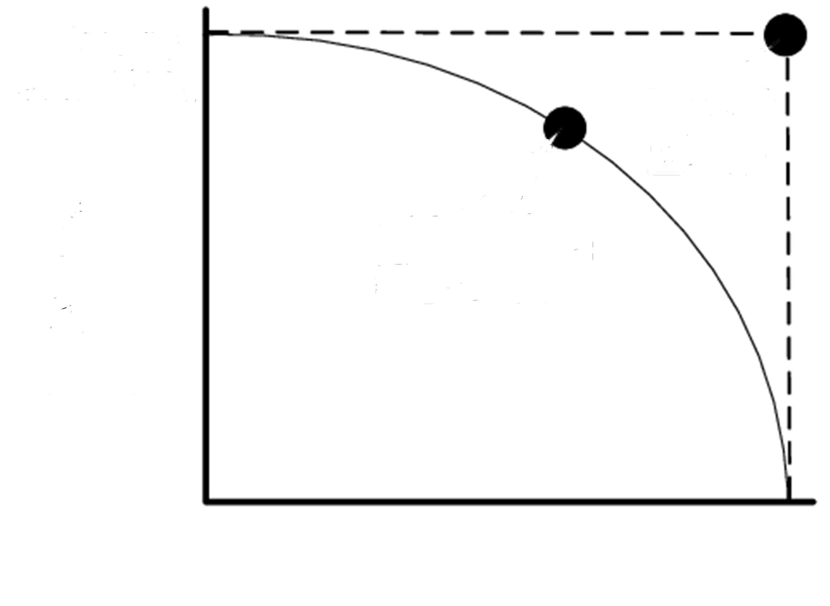
Accuracy Tradeoffs
Increase fairness by reducing bias in AI model
Increase accuracy by using all data without constraints
Possible compromise between fairness and accuracy
Ideal situation (impossible to obtain)
High
Fairness
Low
Low
High
Accuracy

Slide 20


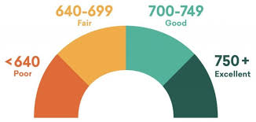
Liberty Tradeoffs
Increase fairness by giving advantage to disadvantaged group
Increase liberty by creating a level playing field with minimum constraints
680
710

Slide 21

Utility Tradeoffs
Increase fairness by not discriminating against groups
Increase overall utility by favoring some groups over others

Slide 22
Activity: Discussing Fairness Tradeoffs
Scenario: Consider the RudiBrace product, or a product from your workplace. The RudiBrace team members discuss what would be most fair: to boost the productivity score of employees with a care duty due to their family situation or to generate the same productivity scores for all employees.
What argument would you make if you were in favor of boosting scores, based on different notions of fairness?
What argument would you make if you were against boosting scores, based on different notions of fairness?

Slide 23
Mitigate Bias Risks
Topic D

Slide 24
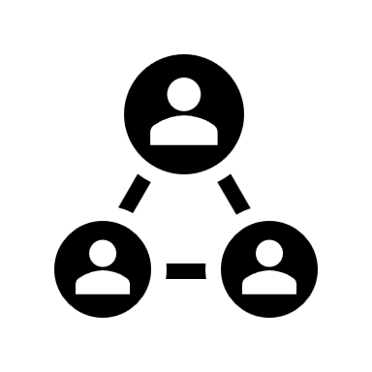

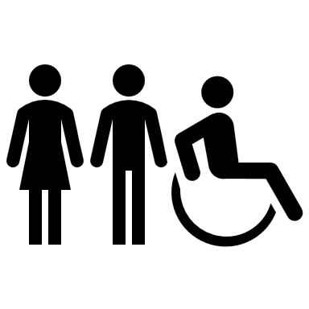
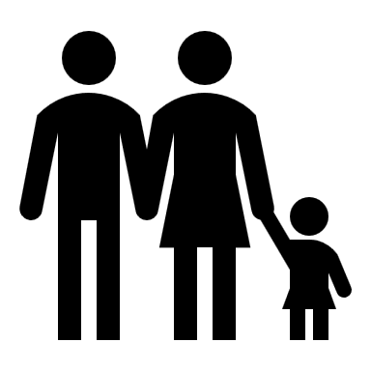
Bias Risk Mitigation Strategies
Inclusive and diverse product teams
Engagement with relevant stakeholders
Technical strategies to reduce bias

Slide 25
Product Team Diversity
Guidelines for ensuring diversity in teams
Address inherent and acquired diversity.
Consider diversity during team composition.
Provide speak-up opportunities.

Slide 26
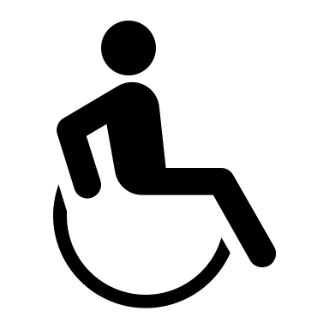

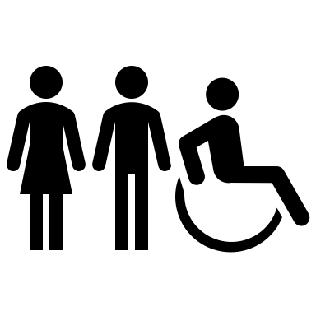

Inclusive Design
Inclusive design principles
Recognize exclusion.
Solve for one, extend to many.
Learn from diversity.
Conduct user studies.
For data-driven technologies
Test different models in different contexts.
Validate systems.

Slide 27


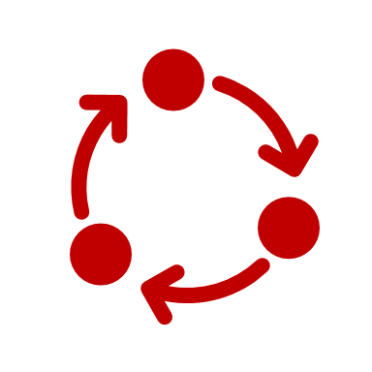



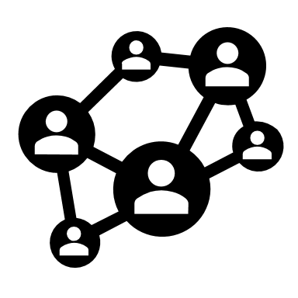
Foreseeability of Fairness Impacts: PESTL and STEEPV
To foresee potential fairness impacts, product teams can use the following frameworks:
PESTL
Political
Economic
Social
Technological
Legal
STEEPV
Social
Technological
Economic
Environmental
Political
Values

Slide 28


Fairness in AI
Before Modeling: Ensure proportionally equal representation in input data.
01
During Modeling: Verify that the model performs equally well for different groups.
02
After Modeling: Assess probability of false positives and negatives across groups.
03

Slide 29



Establishment of AI Fairness Baseline
Optimize technical elements
Techniques of statistical calibration.
Adopt state-of-the-art ML models that reduce bias.
Set and monitor thresholds for fair outcomes.

Slide 30
Activity: Mitigating Bias Risks
Scenario: Consider the RudiBrace product, or a product from your workplace.
The product team wants to apply inclusive design principles to the RudiBrace product design.
What groups might be inadvertently excluded from the RudiBrace design?
How could these groups still be included in the design?

Slide 31
Which types of bias risk do you think your organization faces most often, and why?
Which of the bias mitigation strategies do you think your organization is most likely to adopt, and why?

